Slide 1
Software Engineering
COCOMO
CONSTRUCTIVE COST
MODEL

Slide 2
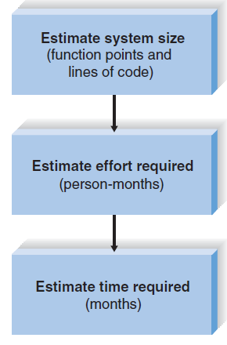
The function point approach
Used to
  Estimate the size of the new system
  The effort that will be required to complete the system
  The time the project will require
It is a three-step process.

Slide 3
Step 1: Estimate System Size
A function point is a measure of program size that is based on the system’s number and complexity of inputs, outputs, queries, files, and program interfaces.
The project manager records the total number of each component that the system will include, and then breaks down the number to show the number of components that have low, medium, and high complexity.
To create a more realistic size for the project, a number of additional system factors such as end-user efficiency, reusability, and data communications are assessed in terms of their effect on the project’s complexity.

Slide 4
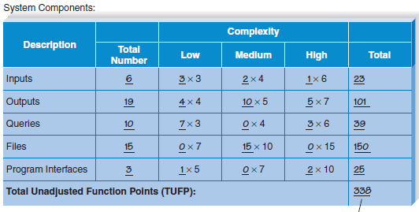

Slide 5
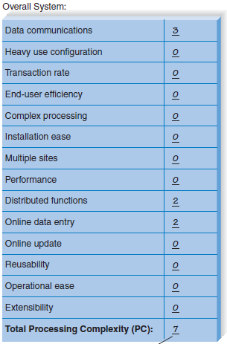
(0 = no effect on processing complexity; 3 = great effect on processing complexity)
APC factor has a baseline value of 0.65
Adjusted Project Complexity (APC):
.65 + (0.01 x 7 ) = .72
Total Adjusted Function Points (TAFP):
.72 (APC) x 338 (TUFP) = 243 (TAFP)

Slide 6
Adjusted Project Complexity
APC value that ranges from 0.65 for very simple systems to 1.00 for “normal” systems to as much as 1.35 for complex systems.
  A very simple system that has 200 unadjusted function points would have a size of 130 adjusted function points (200 * .65 = 130).
  If the system with 200 unadjusted function points were very complex, its function point size would be 270 (200 * 1.35 = 270).
In the planning phase, the exact nature of the system has not yet been determined, so it is impossible to know exactly how many inputs, outputs, and so forth will be in the system. It is up to the project manager to make an intelligent guess.

Slide 7
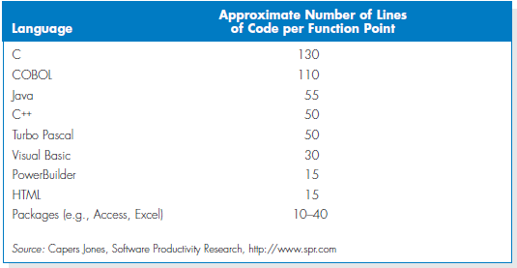
Lines of code
Convert the number of function points into the lines of code that will be required to build the system.
243 function points.
COBOL require approximately
26,730 lines of code to write it.
Visual Basic take 7290 lines of code.

Slide 8
Estimating Staff and Project size

Slide 9
Boehm introduces three forms of COCOMO. It can be applied in three classes of software project:
COCOMO ( Constructive Cost Model ) was proposed by Boehm. This model estimates the total effort in terms of “person-months” of the technical project staff.
Organic mode : Relatively simple , small projects with a small team are handled . Such a team should have good application experience to less rigid requirements.
Semidetached mode:
For intermediate software projects(little
complex compared to organic mode projects in terms of size). Projects may have a mix of rigid and less than rigid requirements.
Embedded mode: When the software project must be developed within a tight set of hardware and software operational constraints. Ex of complex project: Air traffic control system
1

Slide 10
DEVELOPMENT MODE WITH PROJECT CHARACTERISTICS:
Development | Project Characteristics
Mode
 | Size | Innovation | Deadline | Dev.
 |  |  |  | Environment
ORGANIC | Small | Little | Not Tight | Stable
SEMI- | Medium | Medium | Medium | Medium
DITACHED
EMBEDDED | Large | Greater | Tight | Complex
 |  |  |  | Hardware

Slide 11
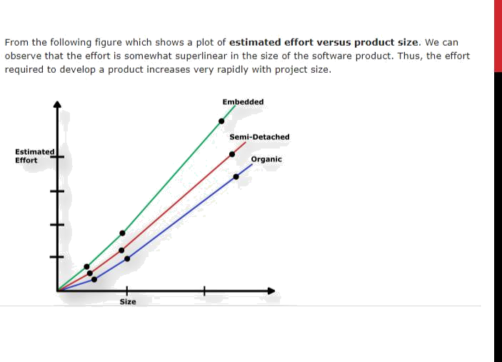

Slide 12
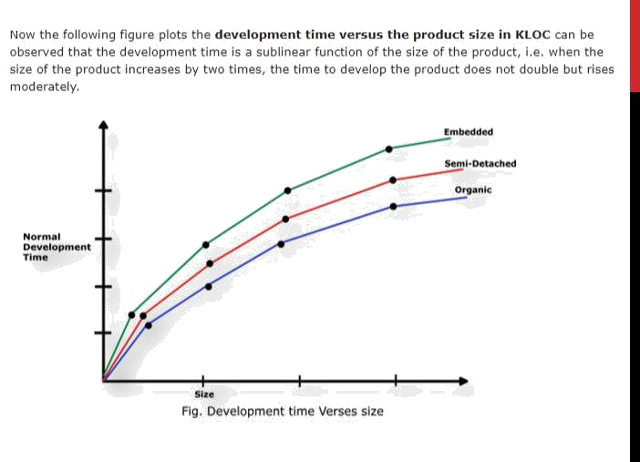

Slide 13

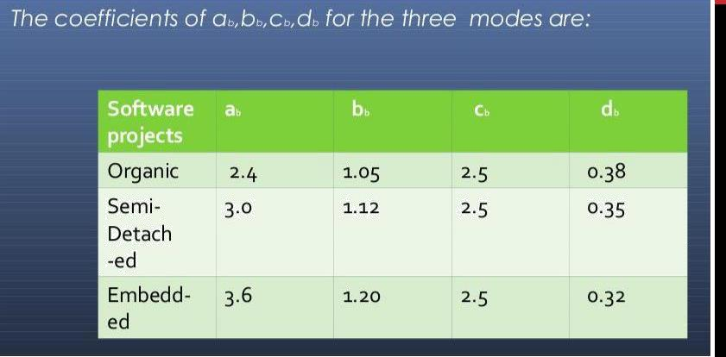
FORMS OF COCOMO MODEL
Basic COCOMO Model
Intermediate COCOMO Model
Complete/Detailed COCOMO Model
Basic COCOMO:
Computes software development effort and cost as a function of programme size expressed in terms of Lines Of Code (LOC).
The basic cocomo model takes the following form: E=ab* ( (KLOC)^bb ) persons-months D=cb*( (E)^db ) months
Where
E = Stands for the effort applied in terms of person months
D = Development time in chronological months KLOC-Kilo lines of code of the project
ab, bb, cb,db are the coefficients for three modes

Slide 14
MERITS AND DEMERITS OF BASIC COCOMO MODEL
Advantages:
Basic COCOMO model is good for quick, early, rough order of magnitude estimates of software project.
COCOMO is simple, because it requires a small amount of data (LOC) to determine the effort and cost. Hence it is a static single- valued model.
Limitations :
The accuracy of this model is limited because it does not consider certain factors for cost estimation of software. These factors are hardware constraints, personal quality and experiences, modern techniques and tools.
Not suitable for rapid , recuse based developments.

Slide 15
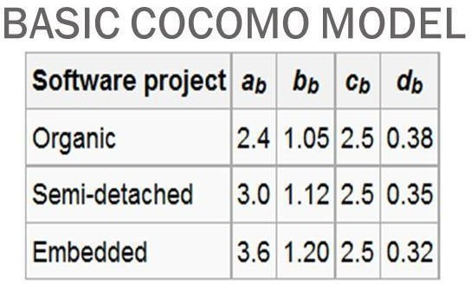
Example: consider a software project using semi-detached mode with
30,000 lines of code . We will obtain estimation for this project as follows:
Effort estimation
E= ab*( (KLOC)^ bb) person-months
E=3.0*( 30^1.12) , lines of code=30000=30000/1000 KLOC= 30 KLOC
E=135 person-month
Duration estimation
D= ( cb *(E^db) ) months
=2.5*(135^0.35)
D= 14 months
(3)Person estimation
N= E/D
=135/14
N=10 persons approx.
Note: you have to memorize the value of these co-efficients

Slide 16
Intermediate COCOMO:
Computes effort as a function of programme size and a lot of cost drivers that includes subjective assessment of product attributes, hardware attributes , personal attributes and project attributes.
The basic model is extended to consider a set of cost driver attributes grouped into 4 categories:
Product Attributes:
  Required software reliability
  Size of application software
  Complexity of the product

Slide 17
(2) Hardware Attributes:
Run-time performance constraints
Memory constraints
Required turn around time
Volatility of virtual machine
Personal attributes:
  Analyst capability
  Software Engineer Capability
  Applications Experience
  Programming language experience
  Virtual machine Experience
Project Attributes:
  Use of software tools
  Required development schedule
  Application of software engineering methods
Now these 15 attributes get a 6-point scale ranging from “very low” to “extra high”. These ratings can be viewed as:
Very Low, Low, Nominal High, High, Very high, Extra high

Slide 18
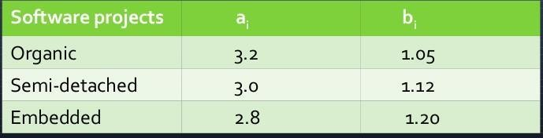
Based on the rating effort multipliers is determined. The product
of all effort Multipliers result in “Effort Adjustment Factor” (EAF). The intermediate COCOMO takes the form.
E=ai *(KLOC^bi)*EAF where
E: Effort applied in terms of person-months KLOC : Kilo lines of code for the project EAF : It is the effort adjustment factor
The values of ai and bi for various class of software projects are:
Memorize the table for maths

Slide 19
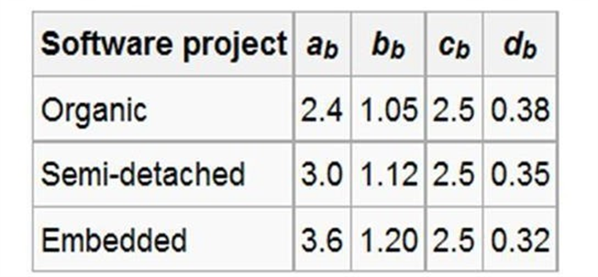
The duration and person estimate is same as in basic COCOMO
model i.e;
D=cb*(E^ db) months
i.e; use values of cb and db
coefficients. [Values of coefficients will not be given. Memorize it.]
N=E/D persons
Merits:
This model can be applied to almost entire software product for easy and rough cost estimation during early stage.
It can also be applied at the software product component level for obtaining more accurate cost estimation.
Limitations:
The effort multipliers are not dependent on phases.
A product with many components is difficult to estimate.

Slide 20
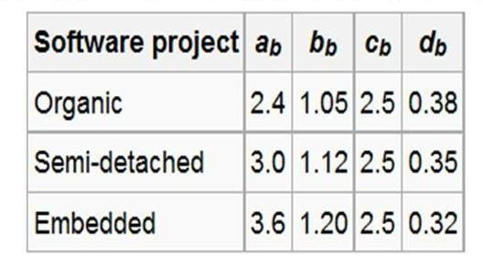
Example:
Consider a project having 30,000 lines of code which in an embedded software with critical area hence reliability is high (EAF=1.15).
The estimation can be E=ai*(KLOC^bi)*EAF
As reliability is high EAF=1.15 (product attribute)
ai = 2.8
bi = 1.20 [for embedded software which will not be
given]
E=2.8*( (30^1.20) )*1.15
=191 person month D=cb*(E^db) = 2.5*(191^0.32)
=13.422 = 14 months approximately
N=E/D
=191/14
N=14 persons approx.

Slide 21
DETAILED/ADVANCED COCOMO MODEL:
A major shortcoming of both the basic and Intermediate COCOMO models is that they consider a software product as a single homogeneous entity. However, most large systems are made up several smaller sub-systems. These sub-systems may have widely different characteristics.
The Detailed COCOMO Model differs from the Intermediate COCOMO model in that it uses effort multipliers for each phase of the project. These phase dependent effort multipliers yield better estimates because the cost driver ratings may be different during each phase.
In Advanced COCOMO Model the cost of each subsystem is estimated separately. This approach reduces the margin of error in the final estimate.
Example: A distributed Management Information System (MIS) product for an organization having offices at several places across the country can have the following sub-components:
Database part
Graphical User Interface (GUI) part
Communication part
Of these, the communication part can be considered as Embedded software. The database part could be Semi-detached software, and the GUI part Organic software. The costs for these three components can be estimated separately, and summed up to give the overall cost of the system.

